Slide 1
ELECTRONIC LEAK DETECTION FOR ROOFING, WATERPROOFING and CIVIL MEMBRANES

Slide 2
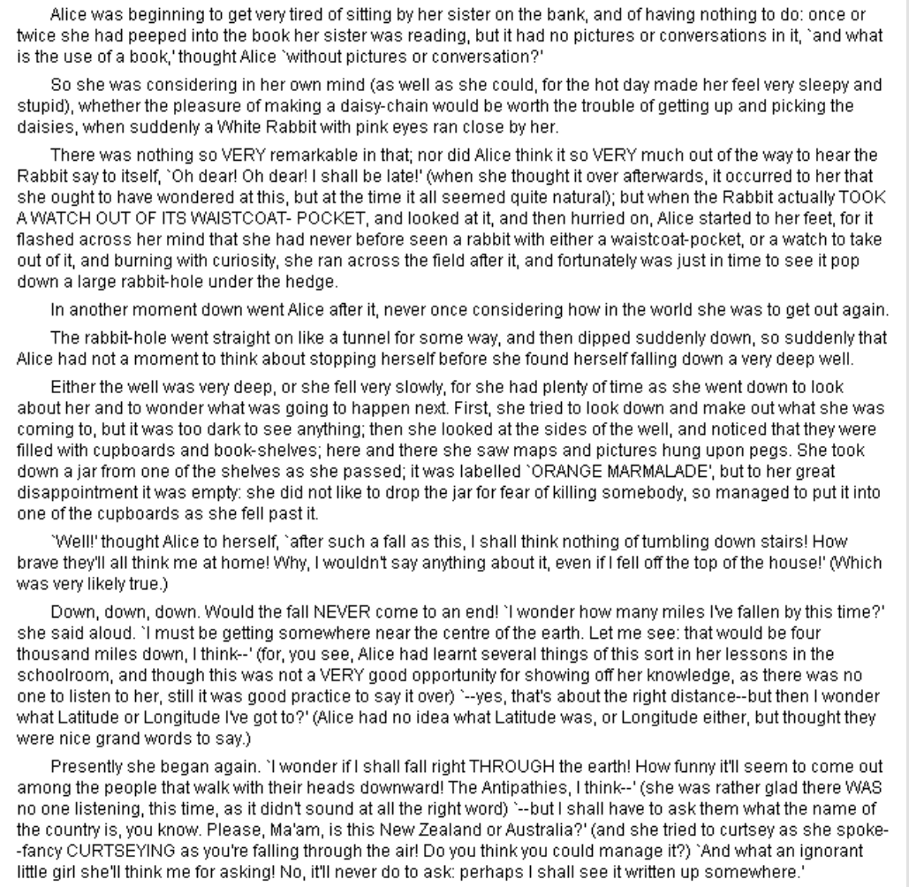
Disclaimer

Slide 3
WHO IS GAUSSAN?
Provides on-demand and full-time (real time) electronic leak detection for roofing, waterproofing and civil membranes
Culmination of years of research and experience in leak detection in civil and structural membranes where flood testing was the standard test method.
The Gaussan Method was developed as a result of the realization that none of the methods of leak detection alone were reliable.

Slide 4
DO YOU DESIGN YOUR ROOFS TO LEAK?

Slide 5
Our On-Demand and Real-Time systems show that 40% of roofs leak from the get-go. Leakage is detected in 60% of roofs within 1 year.

Slide 6
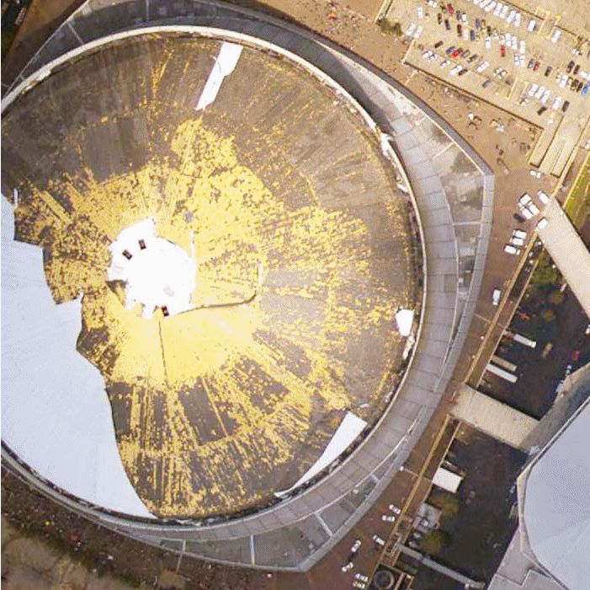
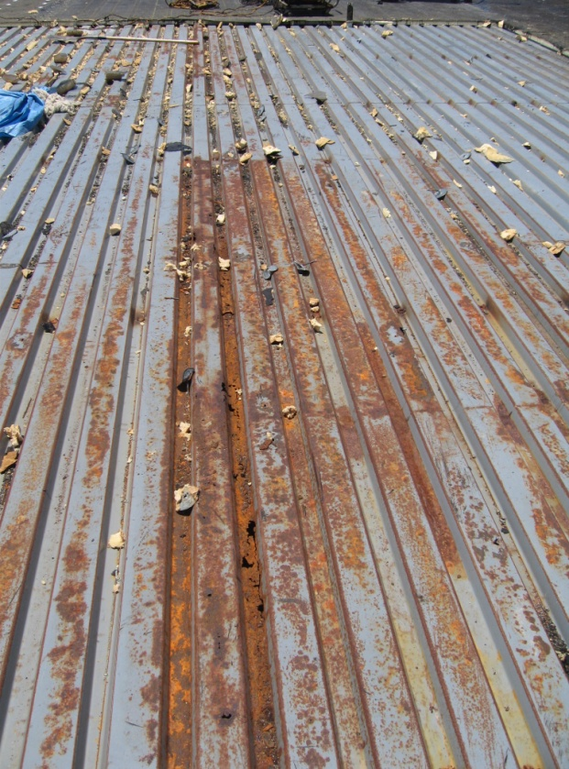
Why Use Electronic Leak Detection:
Identify Leaks that are not obvious
SUPERDOME – NEW ORLEANS
DAMAGE EXPOSED WHEN ROOF BLOWN OFF IN KATRINA

Slide 7
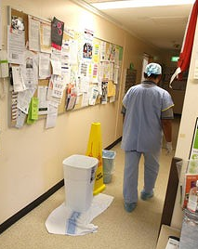
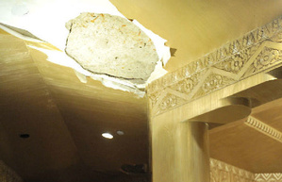
Why Use Electronic Leak Detection:
Protect critical buildings that cannot afford to have any leaks with a continuous monitoring system:

Slide 8
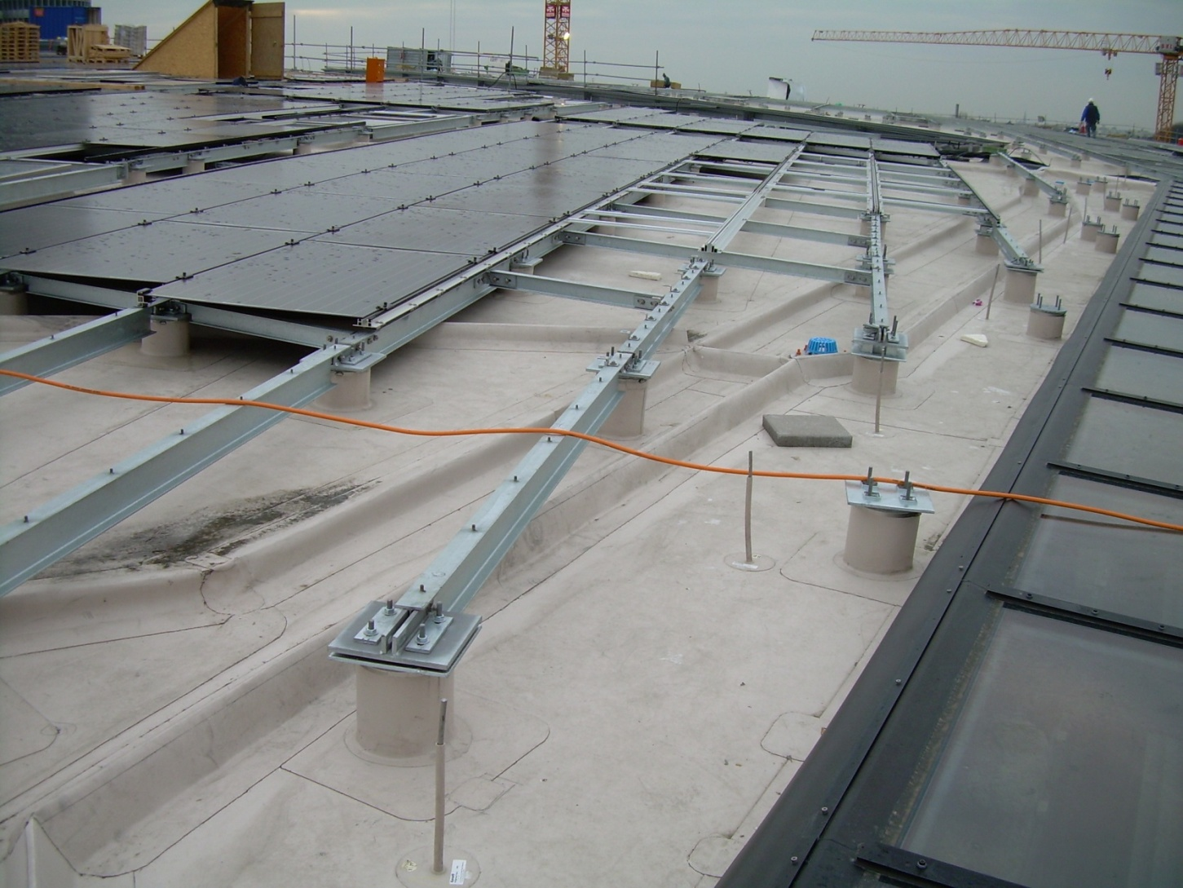
Multiple Penetrations for Solar :

Slide 9
Amenity Spaces and multiple use roofing

Slide 12
GAUSSAN METHOD
Gaussan Technologies (Gaussan Method) provides the unique service of combined On-Demand electronic testing for roofing and waterproofing using high and low voltage protocols.
This protocol resulted from the realization that none of the leak detection methods (flood, High Voltage, Low Voltage, Infrared, Capacitance) were able to effectively and consistently identify and locate leakage in roofing or waterproofing membranes when used by themselves.

Slide 13
Benefits of the Gaussan Method
Statistically higher identification of leaks and potential leaks.
The roof membrane cleared through high voltage testing, repaired and proofed via low voltage testing only requires one mobilization per area.
Test methods build on one another assuring that the roof will be as leak free as possible.
Gaussan LV becomes the QA protocol for the roofing installation.
Gaussan LV data becomes the baseline for the installation of Real-Time leak alert systems and where the application of overburden requires retesting or future testing if leakage problems arise.

Slide 14
Use the building structure as the reference point
Can be a ground
Can be a live source of current

Slide 15
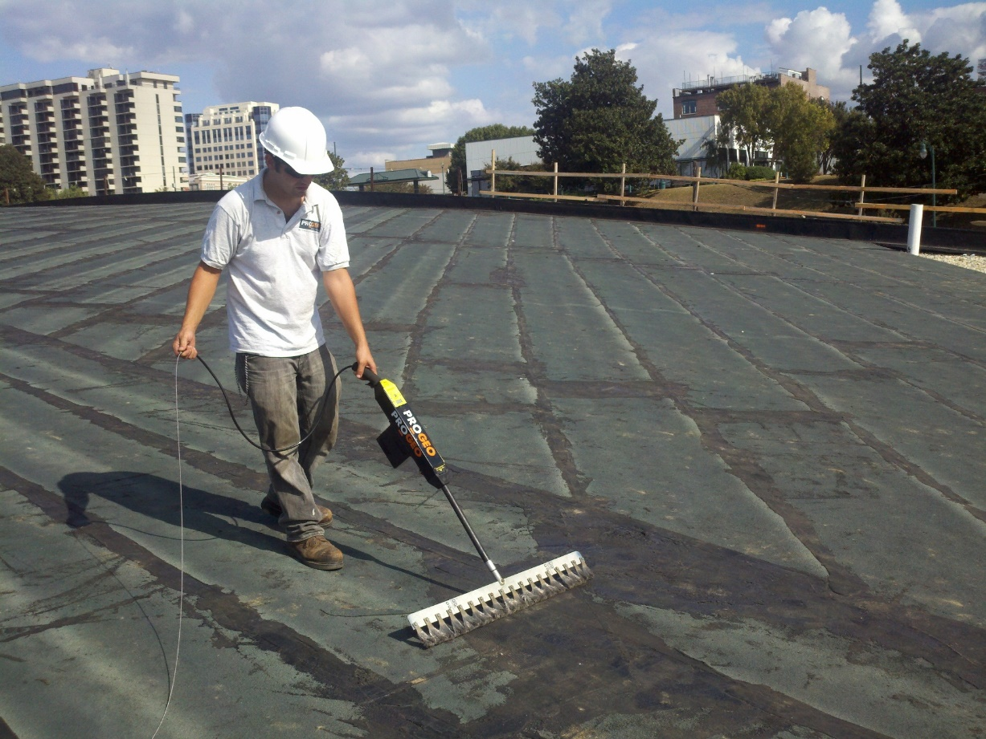
GAUSSAN HV

Slide 16
Up to 35,000 volts

Slide 17
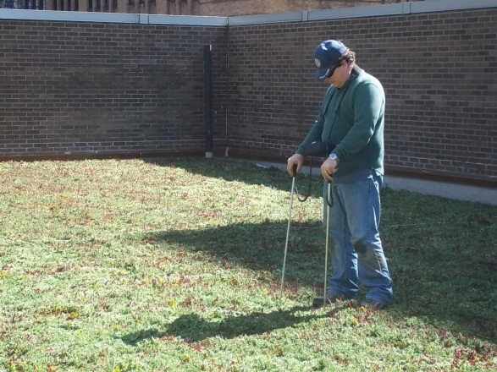
GAUSSAN LV
Gaussan LV (low voltage vector mapping) is a wet test.
Because it is a wet test, the test determines leakage in the membrane through seams, overlaps and inadequate materials.
Gaussan LV will detect potential leakage at “T” seams and other indirect points of potential water penetration which are not detectable by Gaussan HV.

Slide 18
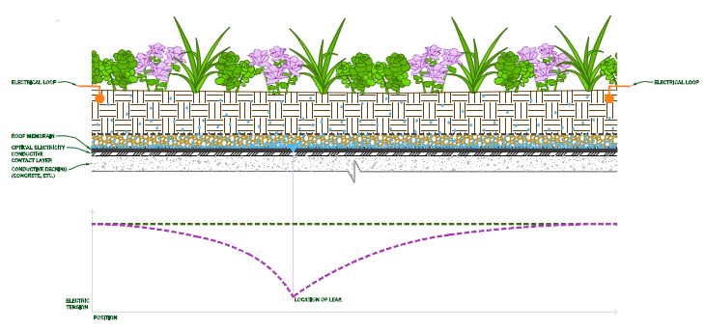
Electronic Leak Testing thru Overburden

Slide 19
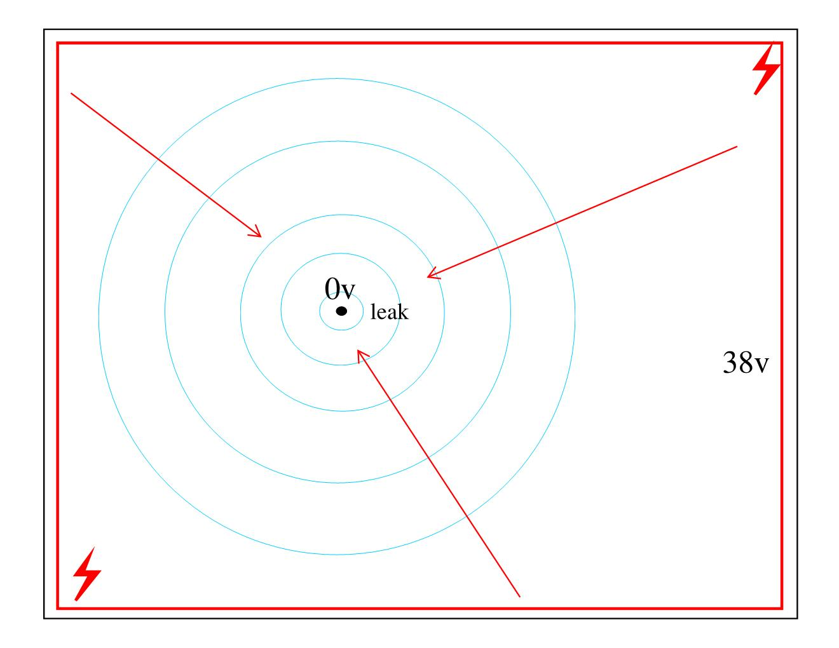

Slide 20
USE PRINCIPLES OF ELECTRICAL RESISTANCE OF MEMBRANES, CONDUCTIVITY OF WATER AND VECTOR MAPPING TO DEVELOP FURTHER LEAK DETECTION SYSTEMS

Slide 21
Gaussan Real-Time leak detection systems are digitally controlled, 24/7 membrane monitoring systems, typically specified where there are mission-critical or other high asset value installations.
Builds on the principles of On-Demand leak detection (Gaussan HV, Gaussan LV).
Every system is designed to meet the conditions of each installation.
Can be applied on top of or underneath the membrane.
Can immediately report trouble in the roofing/waterproofing system.
Web-based system with graphics.
There is a system for almost any budget.

Slide 22
MAKE EXPENSIVE SYSTEMS MORE AFFORDABLE AND MAINTAIN DECENT ACCURACY

Slide 23
INCREASE SENSOR SPACING
REDUCE WIRING AND HUBS
MAINTAIN ACCURACY

Slide 24
TEST FACILITY IN NASHVILLE

Slide 25
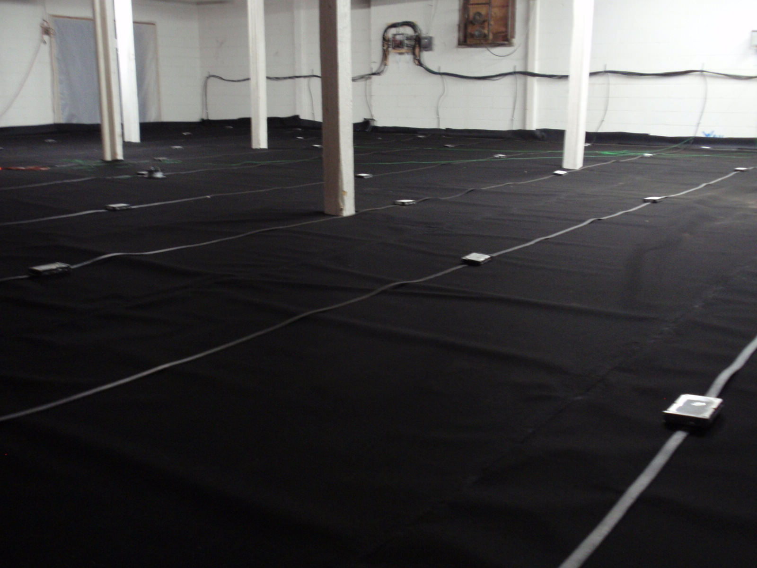

Slide 26
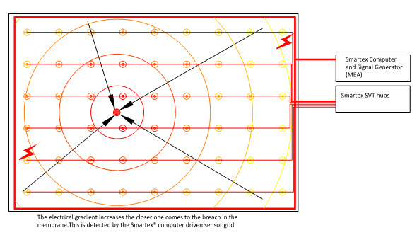

Slide 27
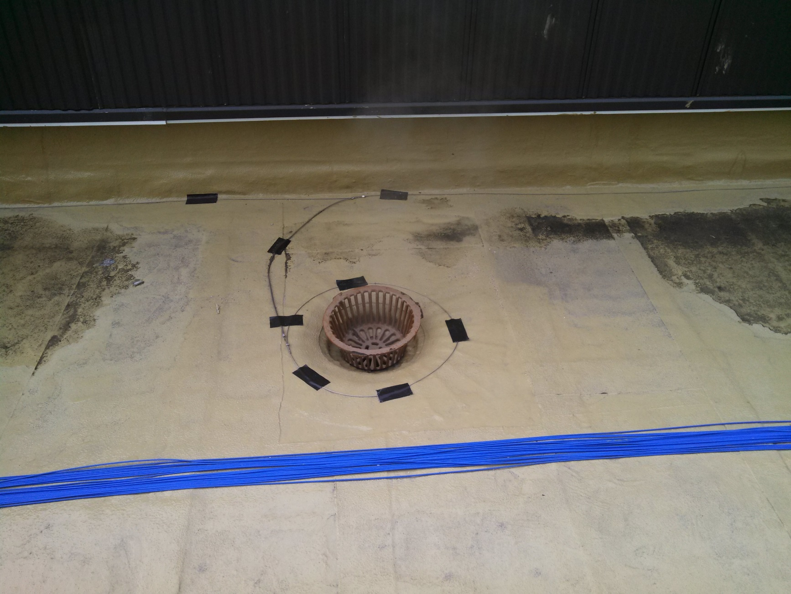
Electrical Screen for Grounded Element in Roof

Slide 28
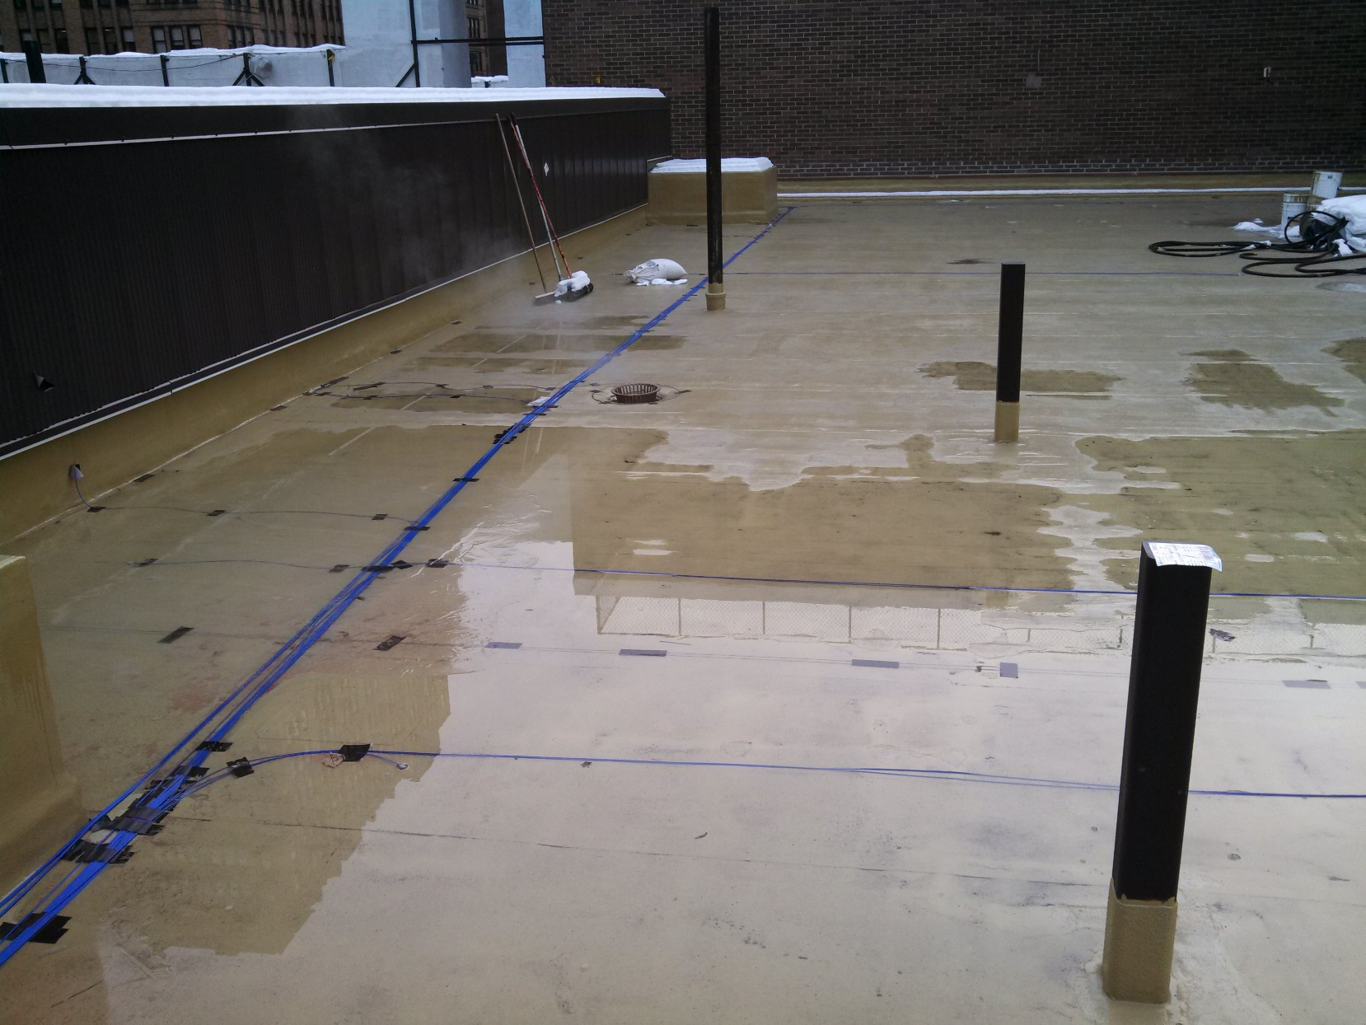
Real-Time Leak Alert Systems
Fashion Institute of Technology

Slide 29
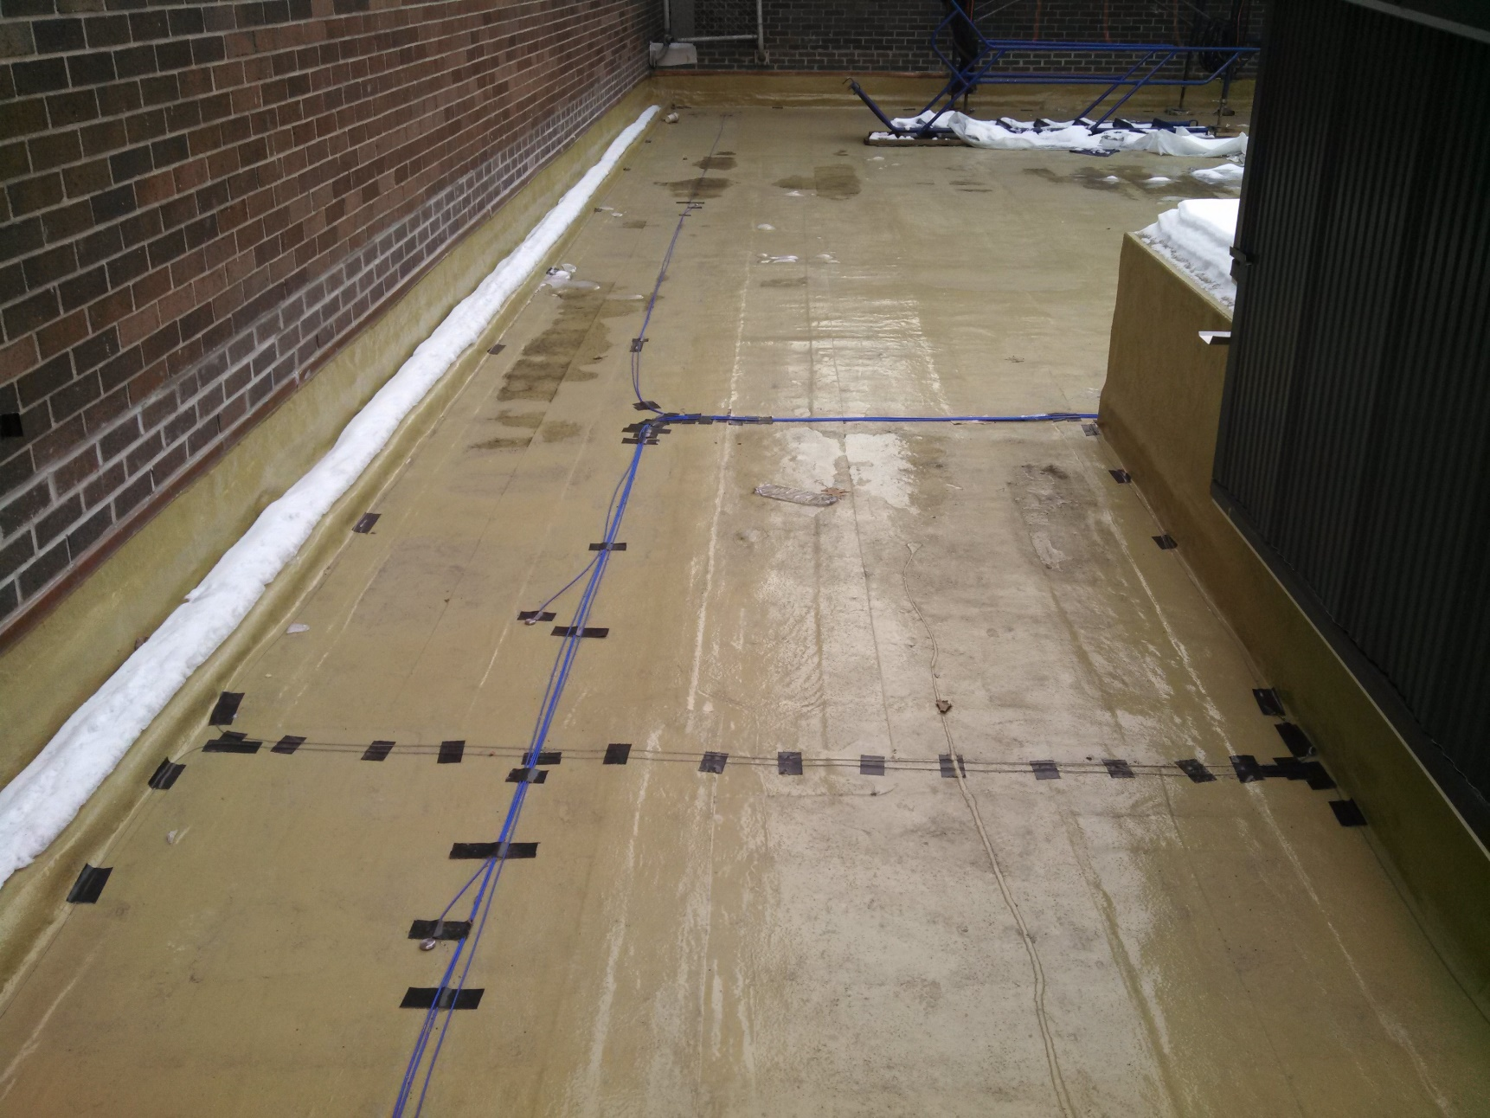

Slide 30
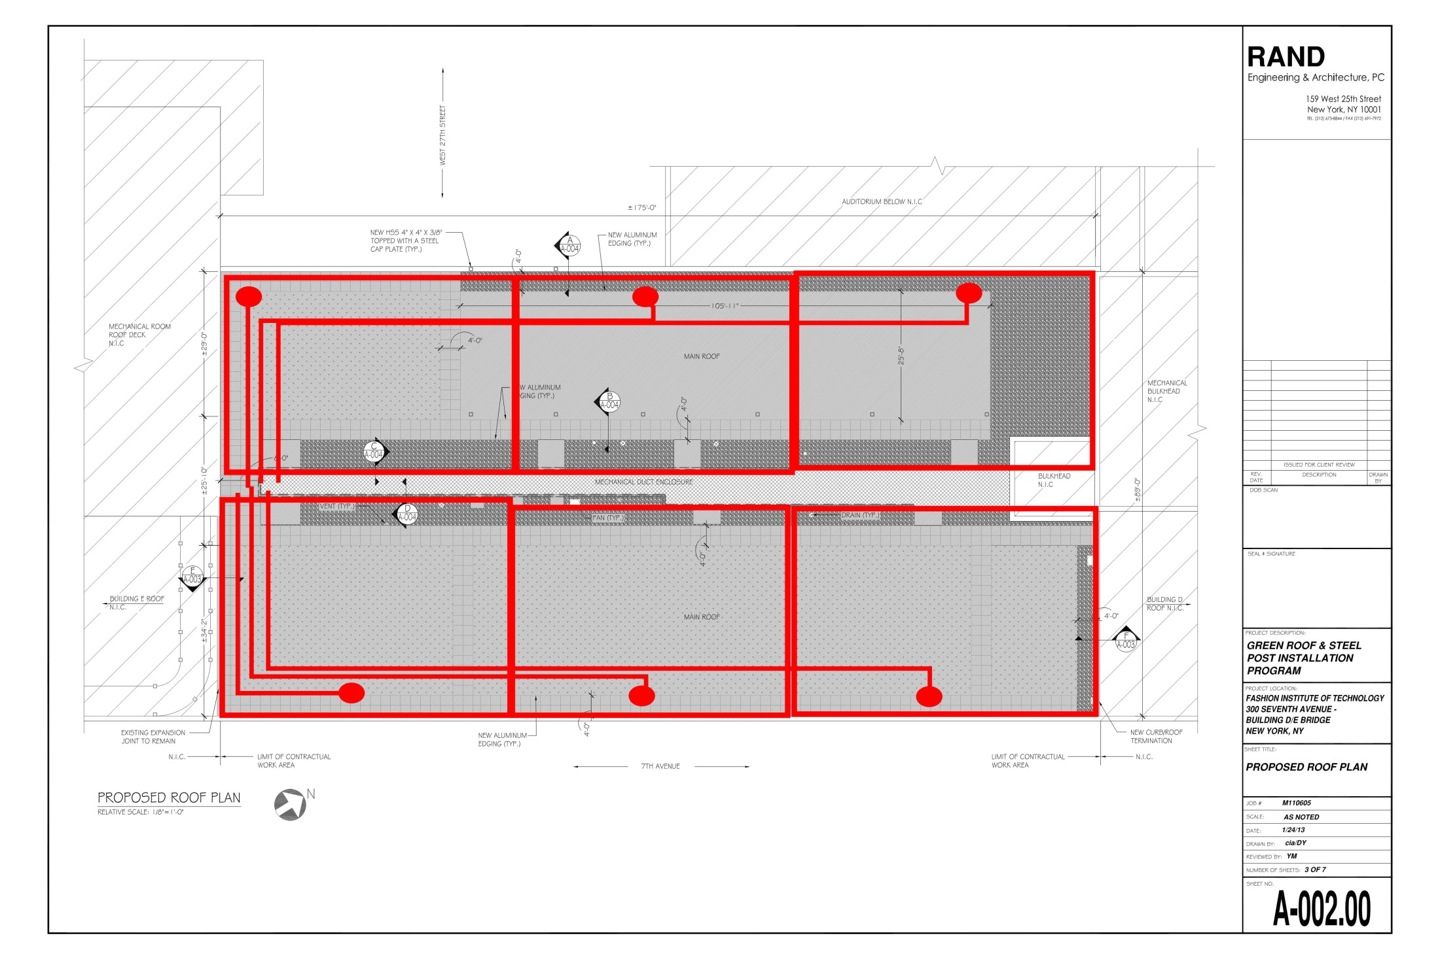

Slide 32
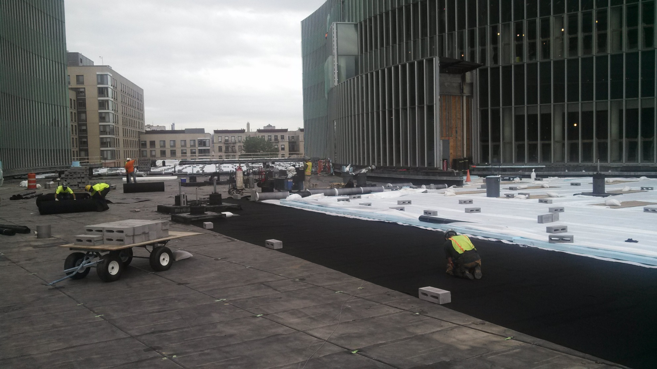
Real-Time Leak Alert Systems
CUNY/ASRC – St. Nicholas Terrace NYC

Slide 33
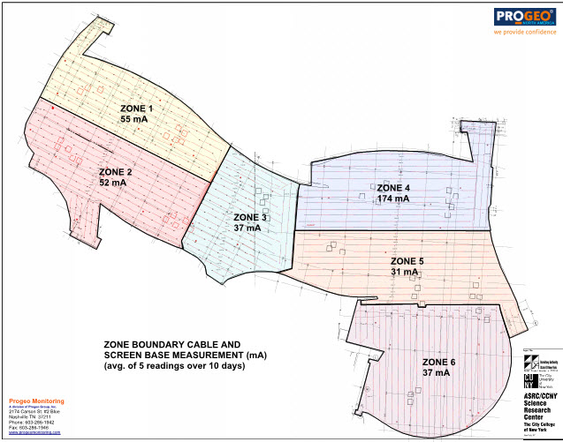

Slide 35
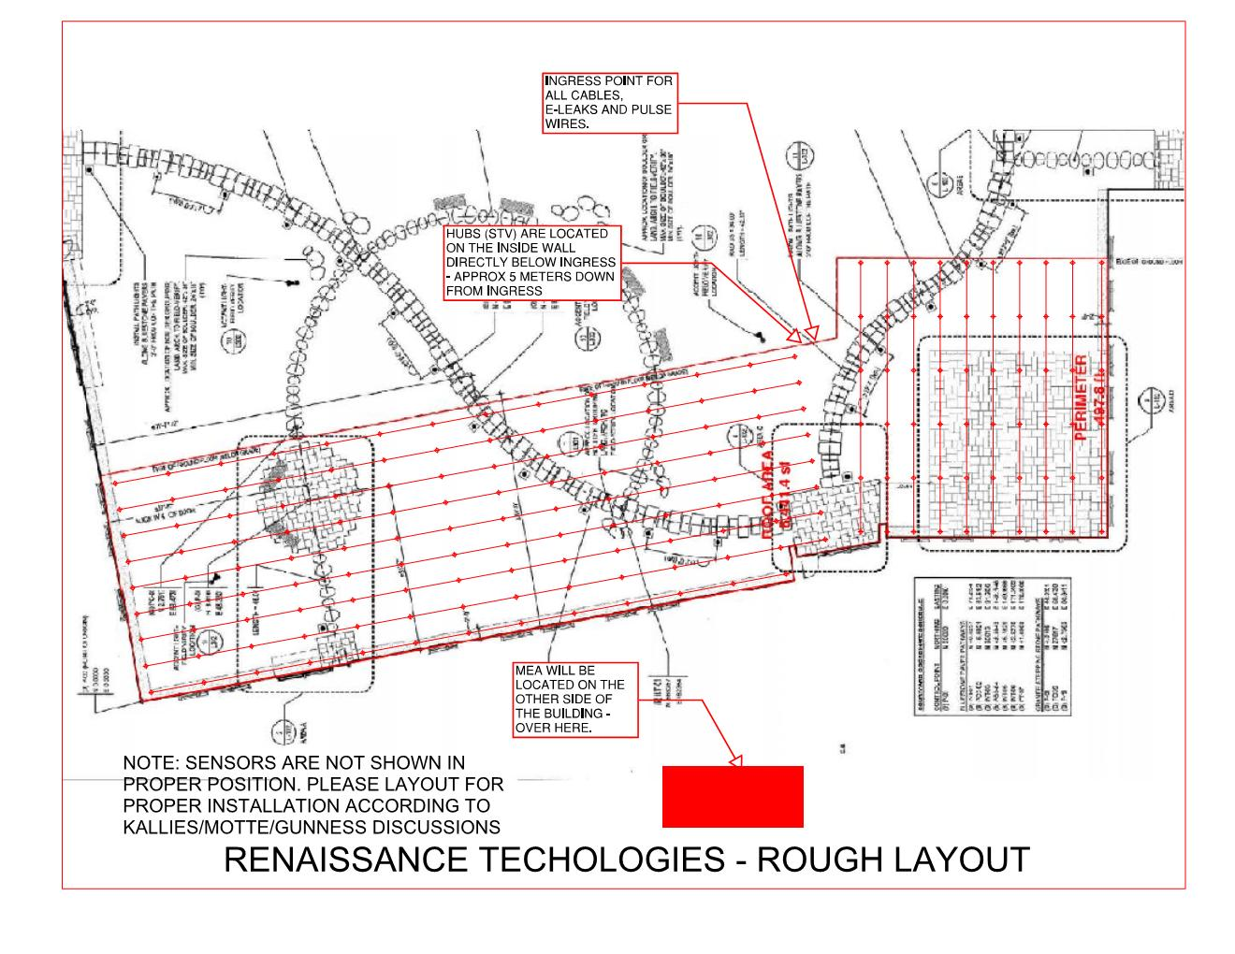

Slide 36
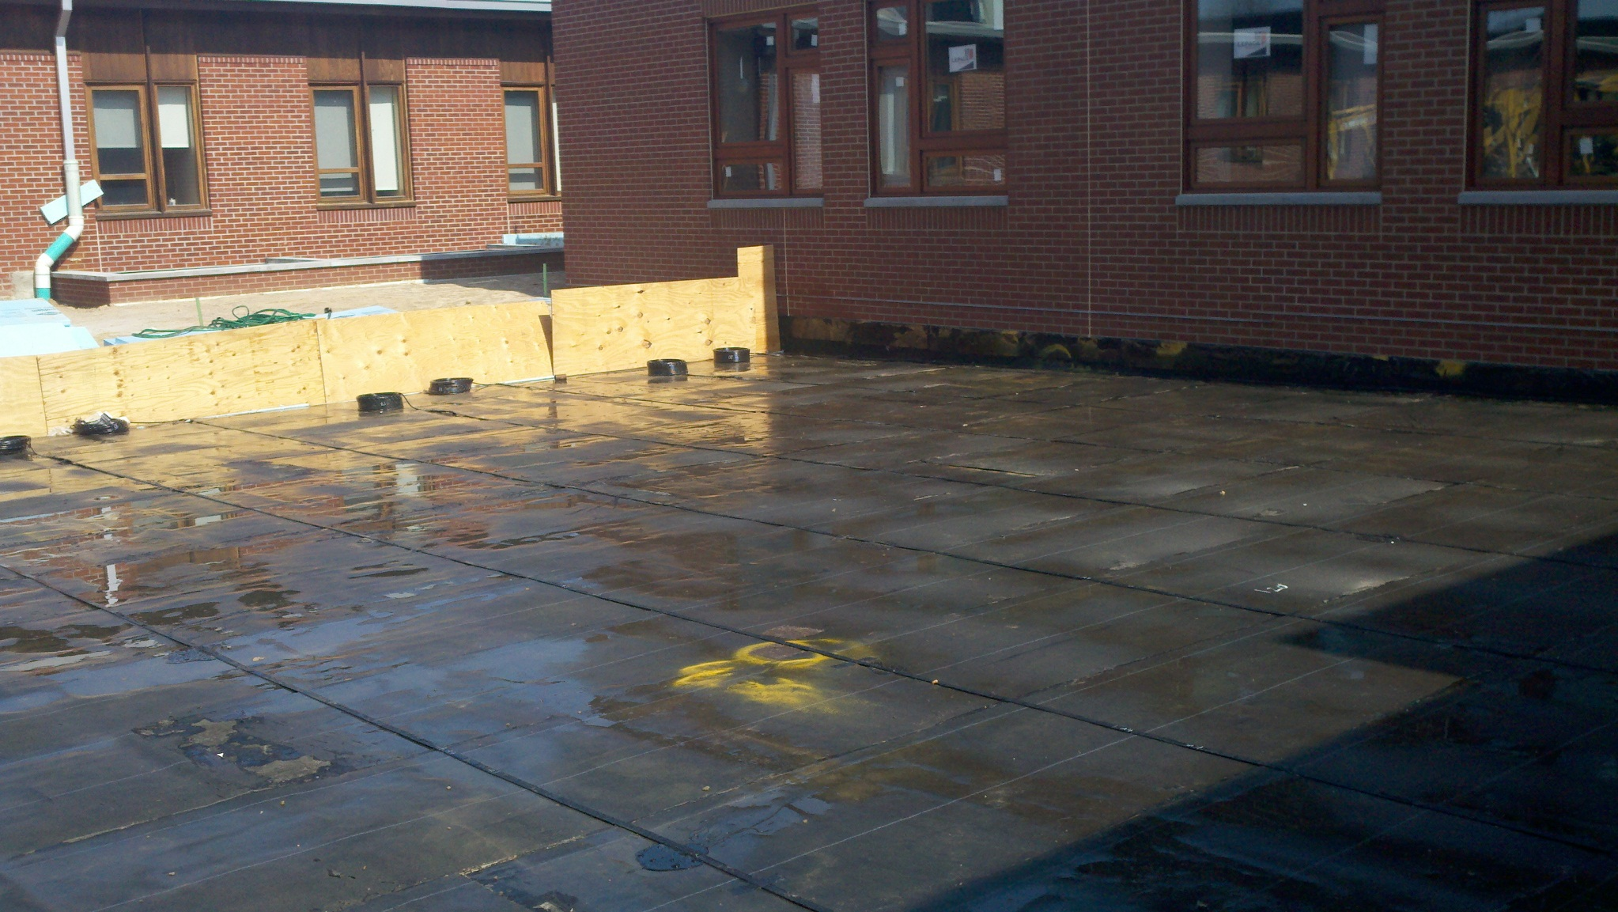

Slide 40
GAUSSAN® PLD
(LEAK DETECTION FOR PIPES)

Slide 42
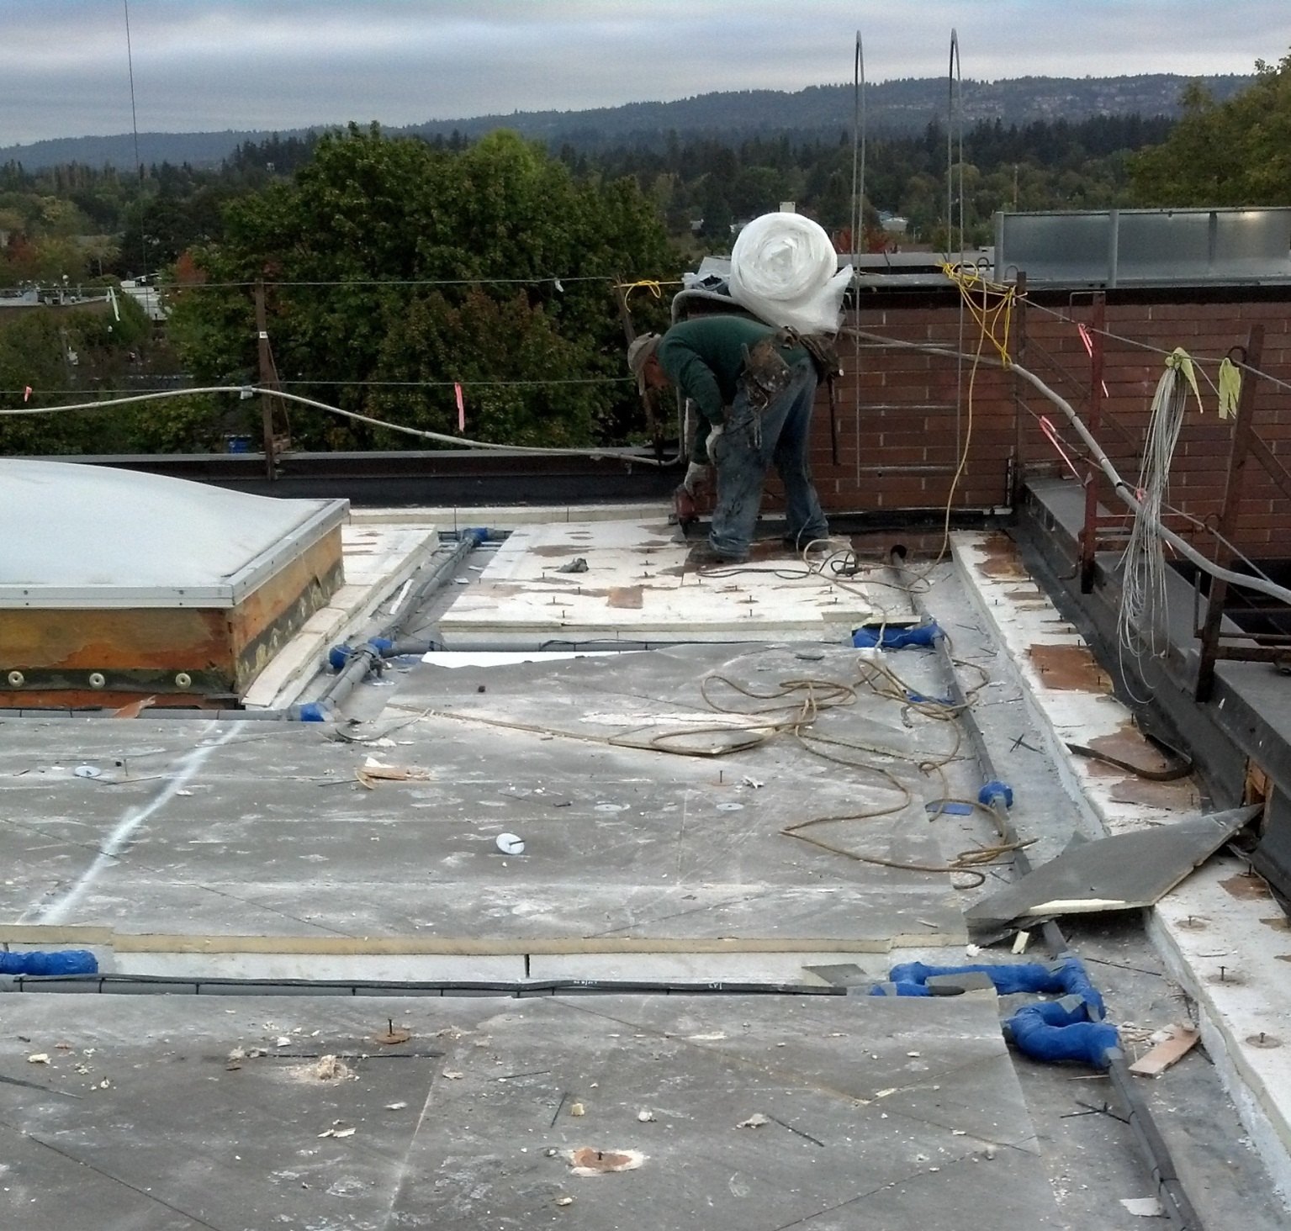

Slide 43
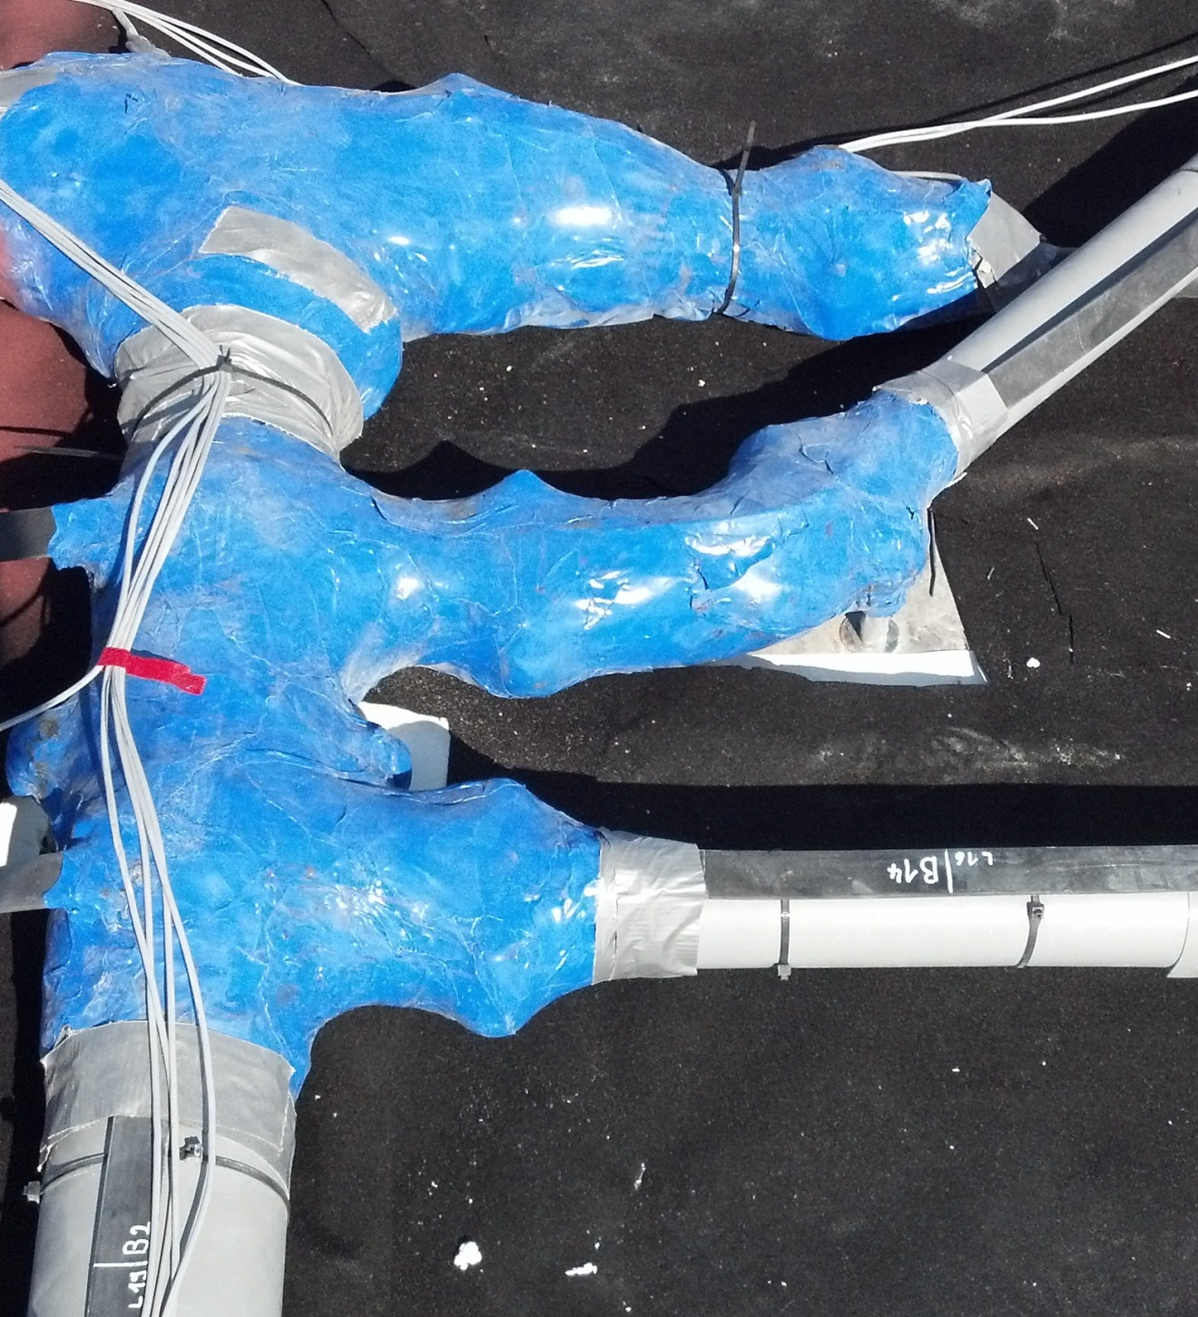

Slide 44
GAUSSAN® EMV
(MULTI-VOLTAGE, VARIABLE FREQUENCY)

Slide 45
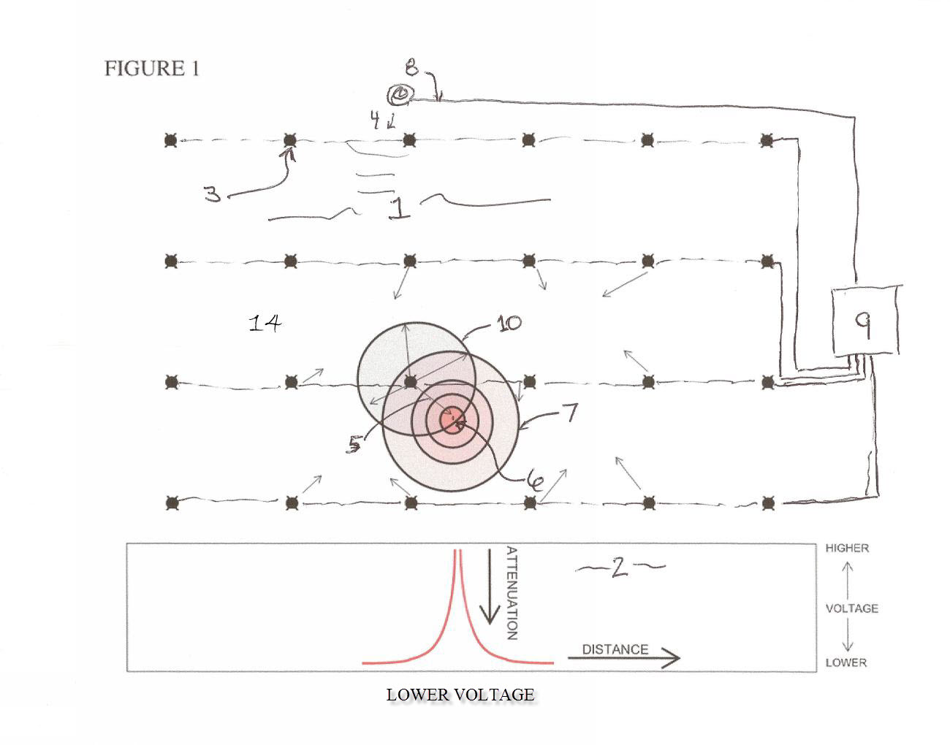

Slide 46
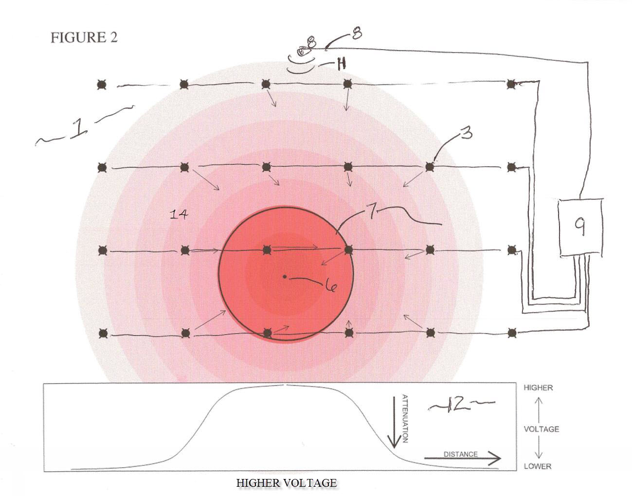

Slide 47
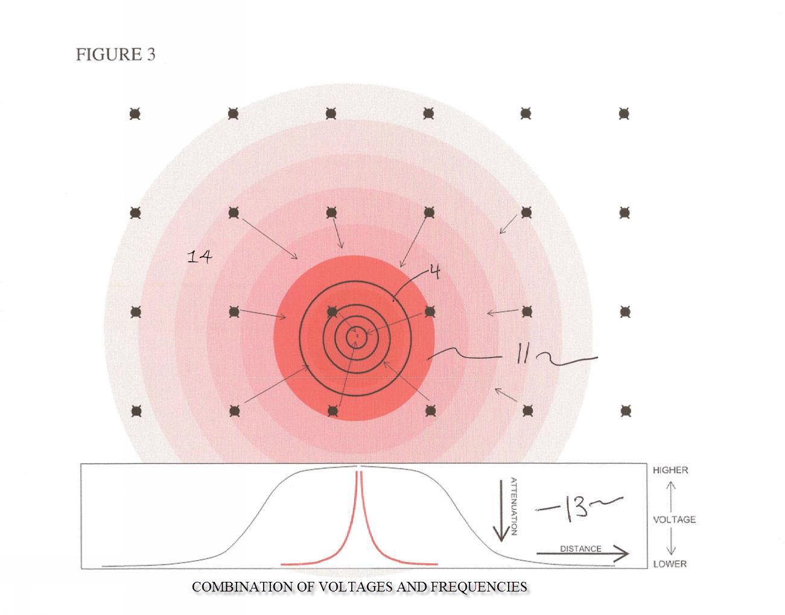

Slide 48
GAUSSAN® VST
WATER VAPOR TRACKING IN THE ROOFING ENVELOPE

Slide 49
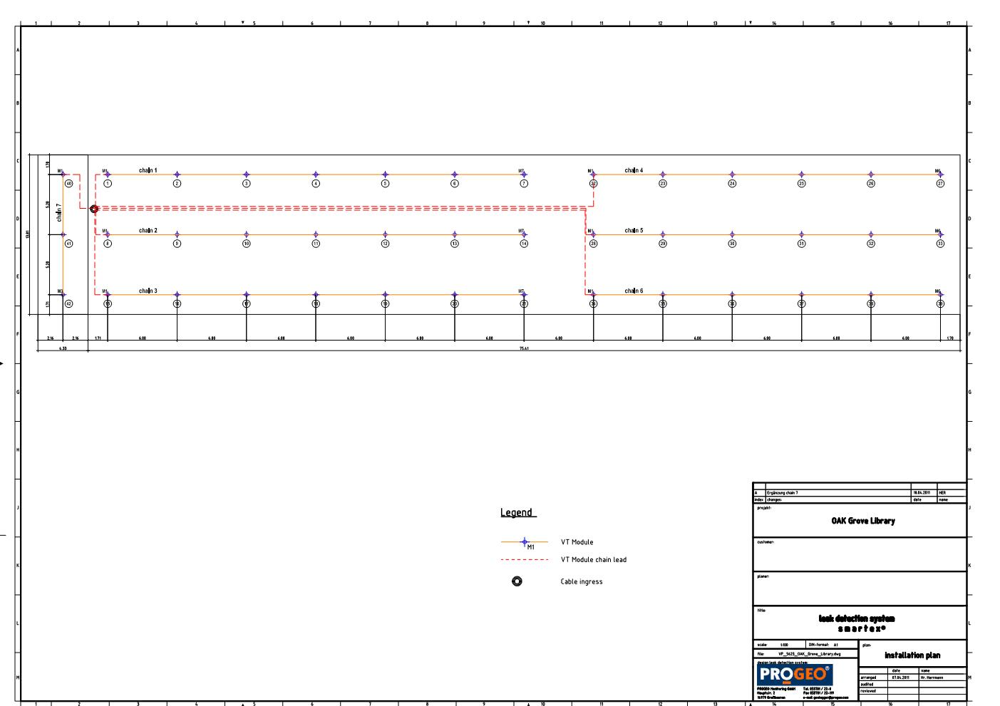

Slide 50
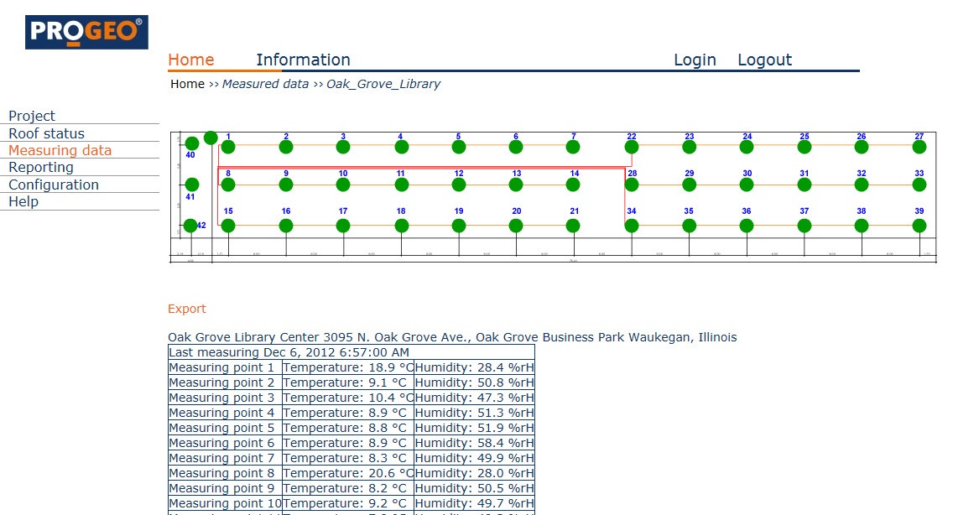

Slide 51
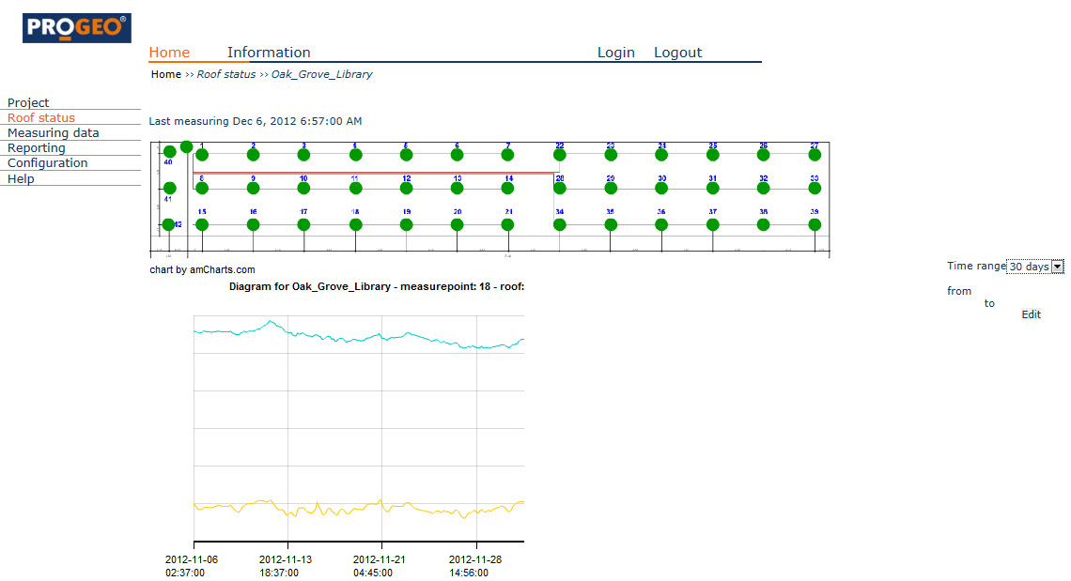

Slide 52
HOW DO WE KNOW IT’S WORKING?

Slide 55
OTHER INFORMATION AVAILABLE FROM SYSTEMS

Slide 56
Isopleths showing readings when the system is pulsed on

Slide 57
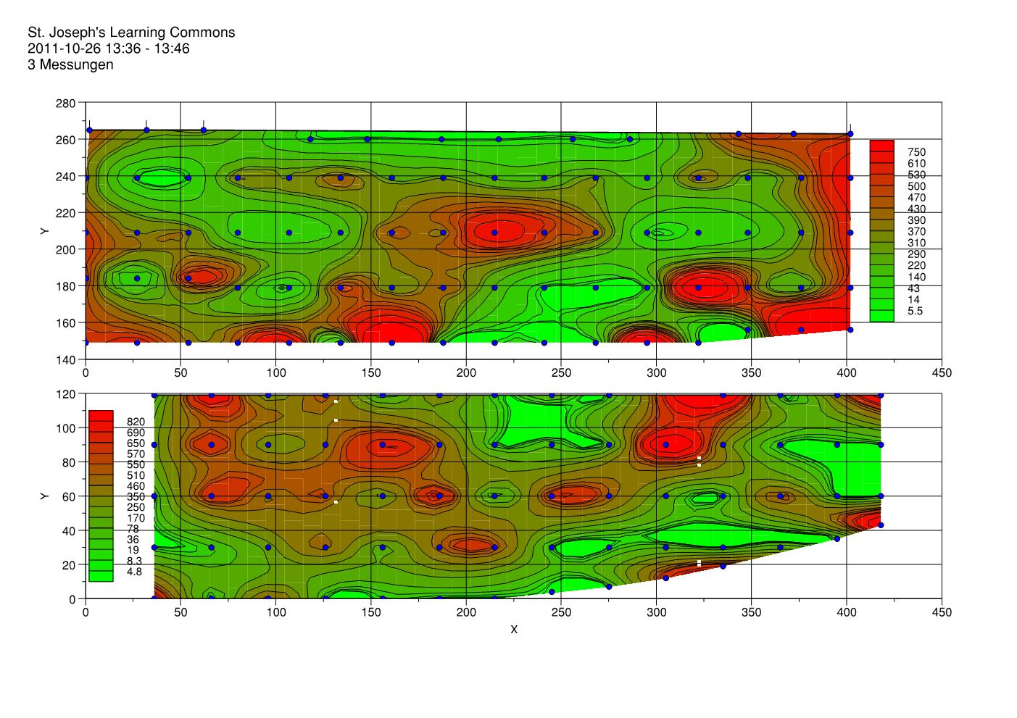

Slide 59
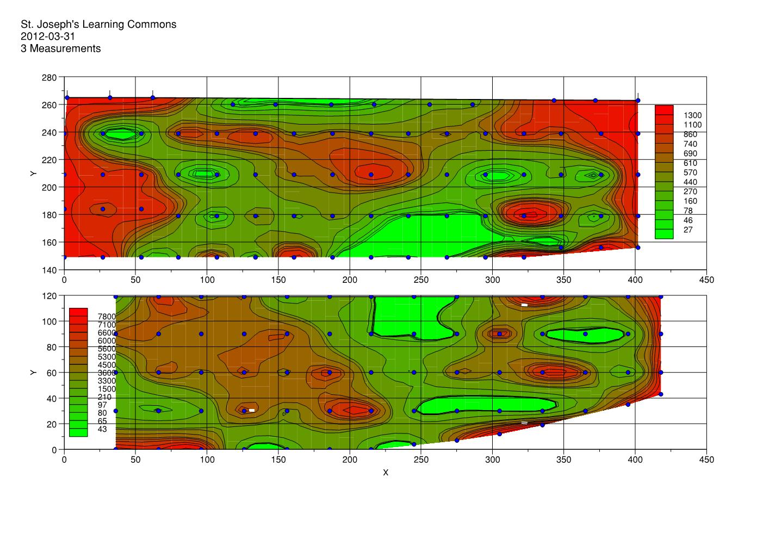

Slide 61
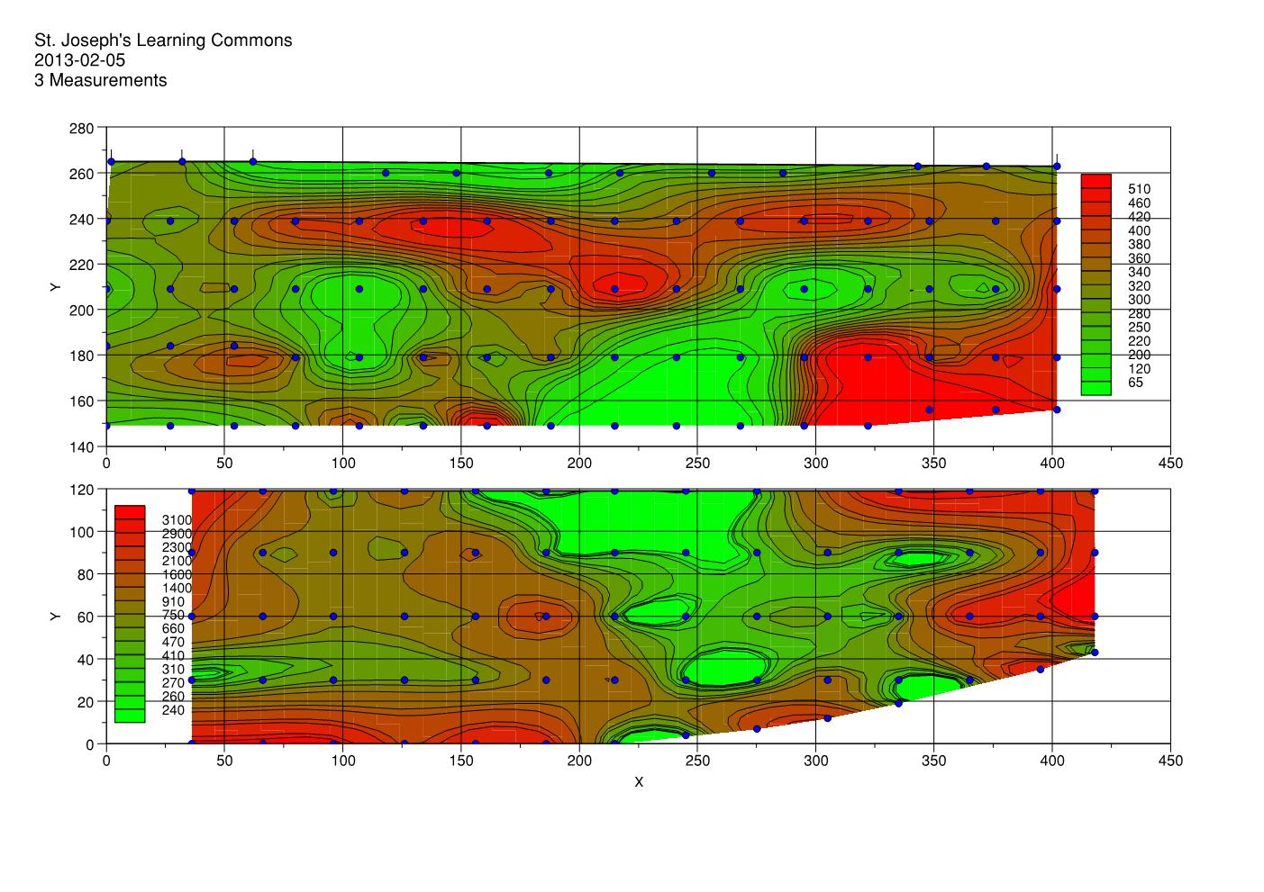

Slide 63
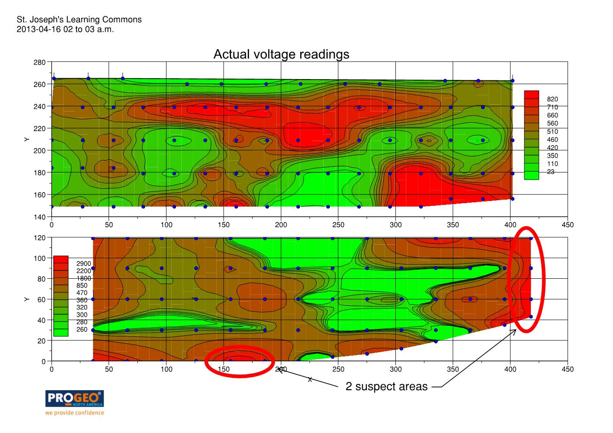

Slide 65
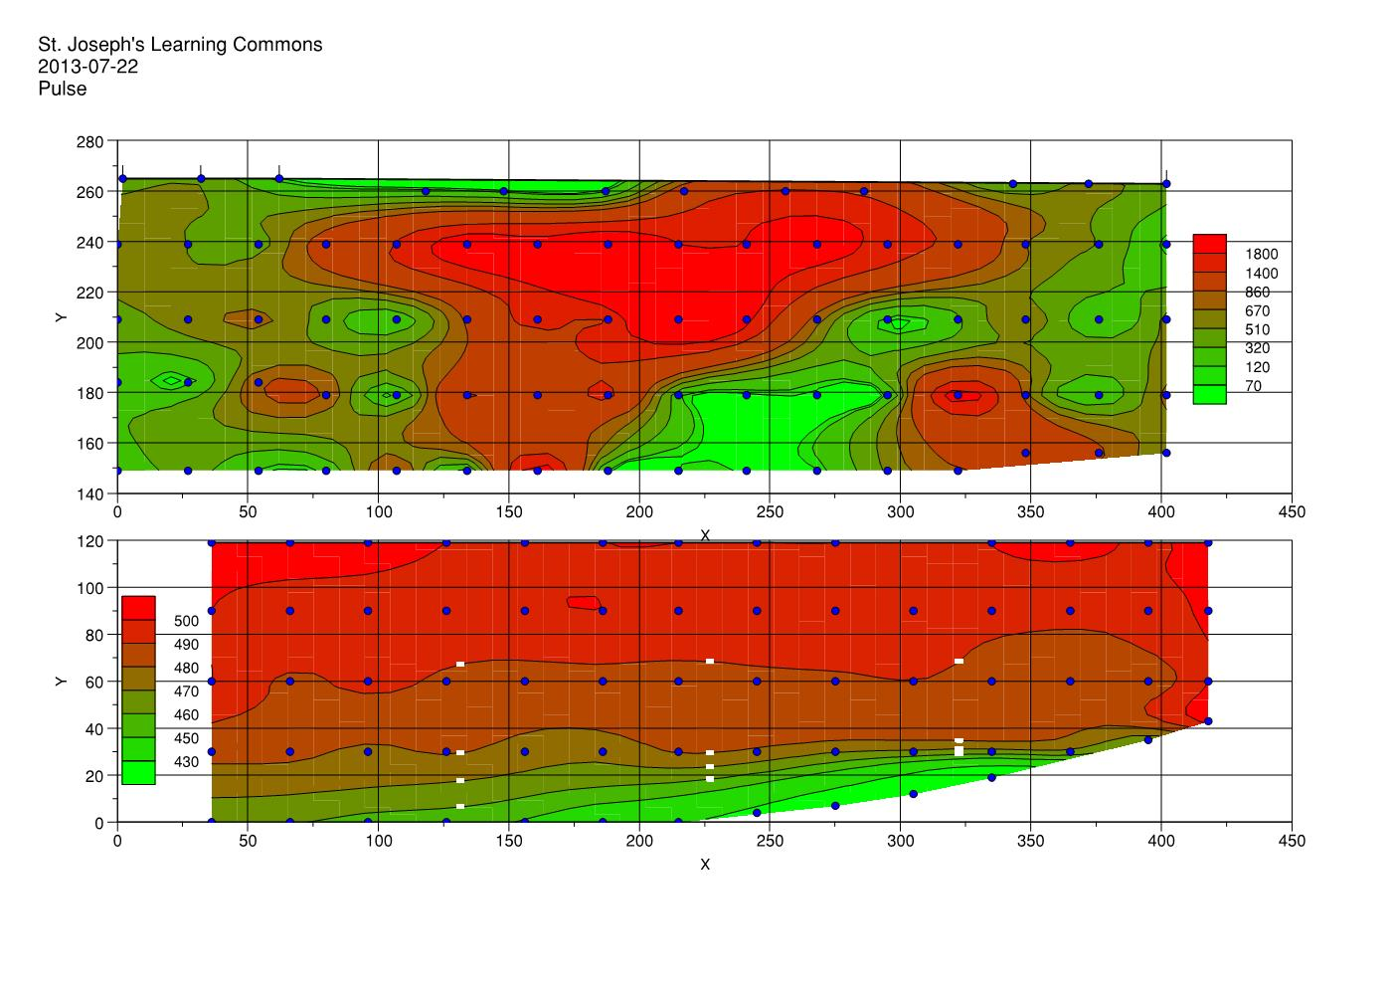

Slide 66
Isopleths showing readings when the system is off…

Slide 67
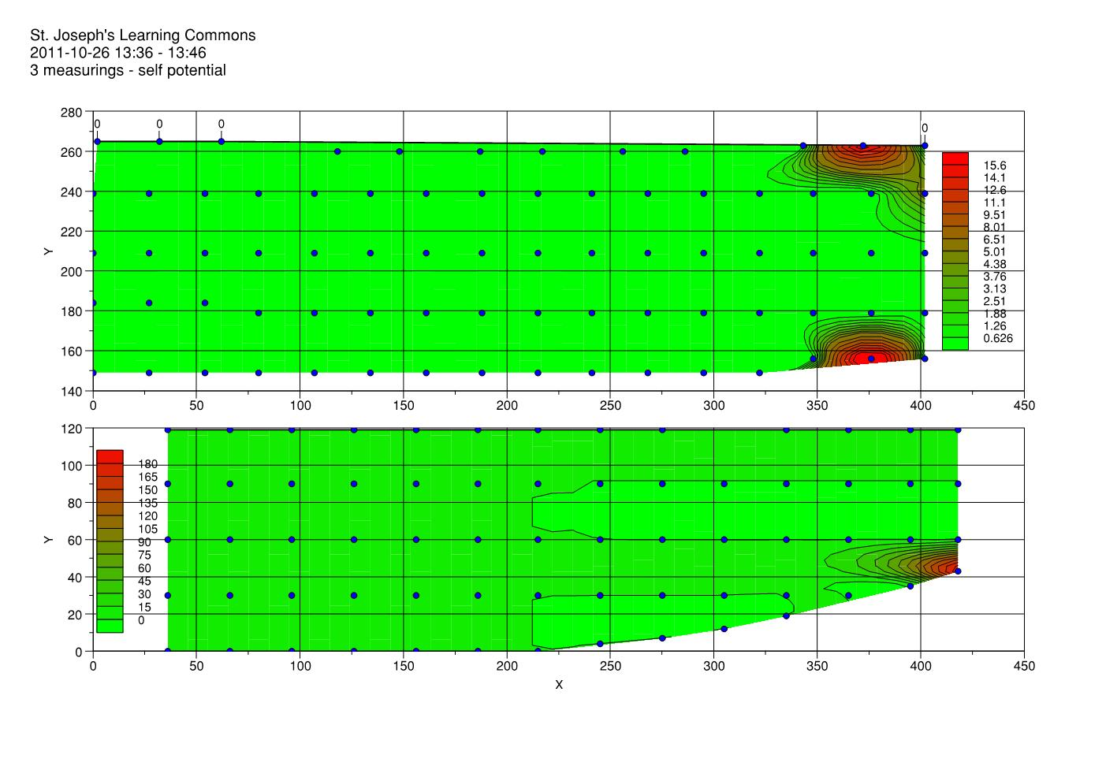

Slide 69
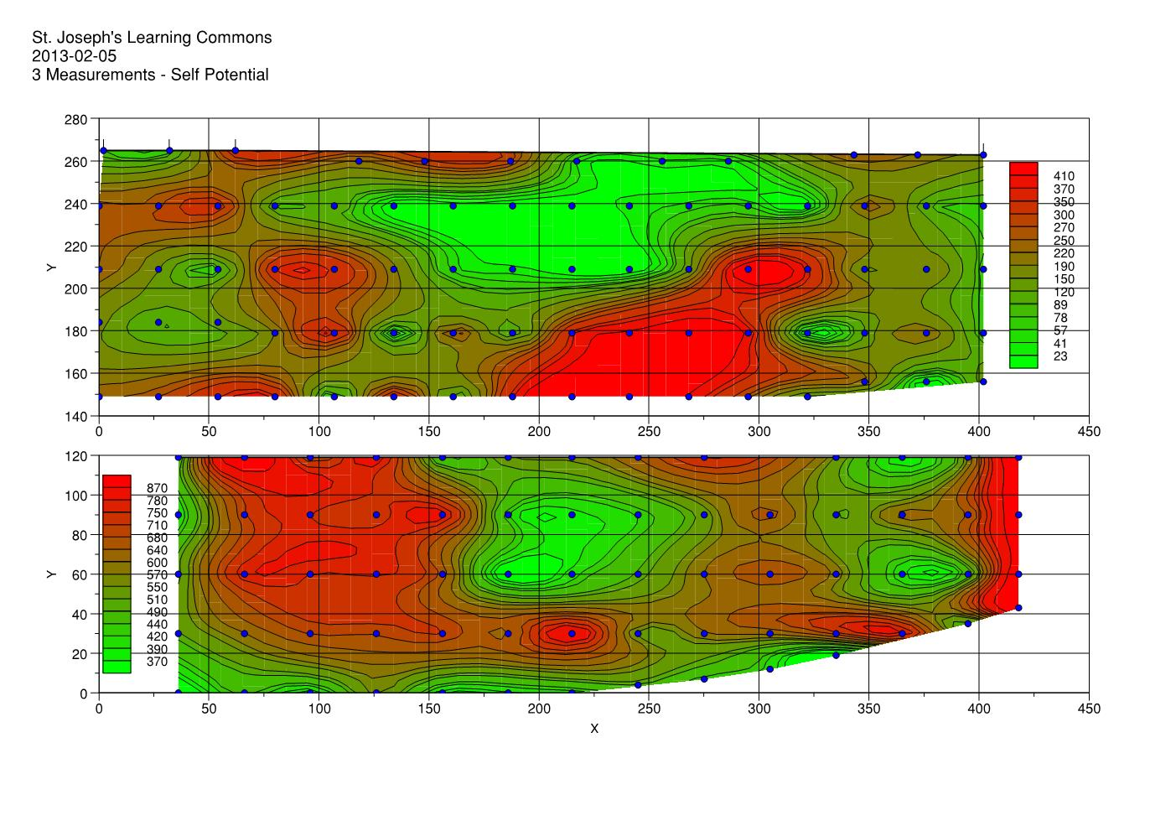

Slide 71
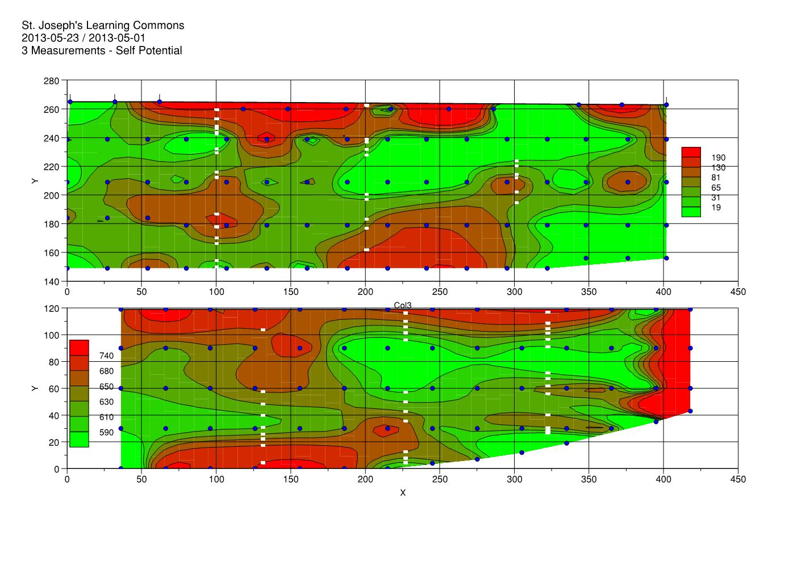

Slide 73
END OF PRESENTATION

